Slide 1
Writing a game bot
Mateusz Janek

Slide 2
Writing a game bot - Agenda
How bots work?
Tools
Examples

Slide 3
How bots work?
Collecting data
Reacting

Slide 4
How bots work? – Collecting data

Slide 5
How bots work? – Collecting data (2)
Reading the screen
Simple
No need to update every game release
Everything needs to be visible
Slow
Cannot do advanced things

Slide 6
How bots work? – Collecting data (3)
Reading the screen
Simple
No need to update every game release
Everything needs to be visible
Slow
Cannot do advanced things
Reading the memory
Nothing needs to be visible
Can do advanced stuff
Fast
Complicated
Update every game release

Slide 7
How bots work? – Collecting data (4)
Reading the screen
Simple
No need to update every game release
Everything needs to be visible
Slow
Cannot do advanced things
Reading the screen
Nothing needs to be visible
Can do advanced stuff
Fast
Advanced
Update every game release
Directly capture messages from server
e.g. Reading server logs with monster loot

Slide 8
How bots work? – Reacting

Slide 9
How bots work? – Reacting (2)
Writting to process memory
Simple
Need to update every game release
Won’t work with online games

Slide 10
How bots work? – Reacting (3)
Writting to process memory
Simple
Need to update every game release
Can’t do advanced things
Won’t work with online games
Simulating mouse and keyboard
Human-like
Working with online games
Can do advanced stuff
No need to update every game release
Complicated

Slide 11
How bots work? – Reacting (3)
Writting to process memory
Simple
Need to update every game release
Can’t do advanced things
Won’t work with online games
Simulating mouse and keyboard
Simple
Human-like
Working with online games
Can do advanced stuff
No need to update every game release
Complicated
Calling game functions
Pretty awesome
Need to update every game release
Detectable

Slide 12
Tools
What Windows offers?
Address searching - CheatEngine

Slide 13
Tools – What Windows offers?
Screen reading
Memory reading
Reacting

Slide 14
Tools – What Windows offers? (2)
Screen reading
Naive way

Slide 15
Tools – What Windows offers? (3)
Screen reading
Naive way
Smart way - PrintWindow()

Slide 16
Tools – What Windows offers? (4)
Memory reading
Process access – OpenProcess()

Slide 17
Tools – What Windows offers? (5)
Memory reading
Process access – OpenProcess()
Memory reading – ReadProcessMemory()

Slide 18
Tools – What Windows offers? (6)
Memory reading
Process access – OpenProcess()
Memory reading – ReadProcessMemory()
Base address

Slide 19
Tools – What Windows offers? (7)
Reacting
Writing memory– WriteProcessMemory()

Slide 20
Tools – What Windows offers? (9)
Reacting
Writing memory– WriteProcessMemory()
Simulating mouse/keyboard (naive way) - mouse_event/keybd_event()

Slide 21
Tools – What Windows offers? (10)
Reacting
Writing memory– WriteProcessMemory()
Simulating mouse/keyboard (naive way) - mouse_event/keybd_event()
Simulating mouse/keyboard (smart way) – PostMessage()

Slide 22
Tools – What Windows offers? (11)
Reacting
Writing memory– WriteProcessMemory()
Simulating mouse/keyboard (naive way) - mouse_event/keybd_event()
Simulating mouse/keyboard (smart way) – PostMessage()
Calling game functions - dllinjection

Slide 23
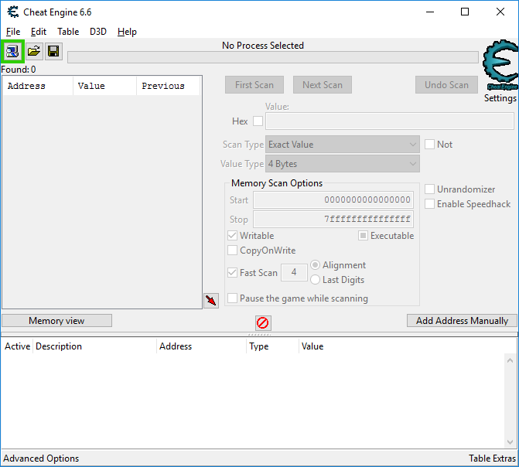
Tools – Searching for the addresses
Cheat Engine – cheatengine.org

Slide 24
Examples
Memory reading
Memory writting
Healer

Slide 25
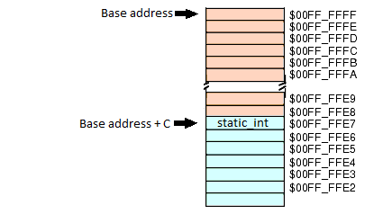
Examples – Memory reading
Base address

Slide 26


Slide 27
Thank you!

